Slide 1

The Prediction of Heart Disease
Raphael Joseph
George Mason University

Slide 2
What’s Cardiovascular Disease?
Cardiovascular disease (CVD) is an illness which involves narrowed or blocked blood vessels that can lead to a heart attack, chest pain (angina) or stroke.
What is cardiovascular disease? American Heart Association. http://www.heart.org/HEARTORG/Support/What-is-Cardiovascular-Disease_UCM_301852_Article.jsp#.WRG85mnyt0w. Accessed May 3, 2017.

Slide 3
Why Cardiovascular Disease?
Claims more than 7 million Lives Every Year.
By 2020, heart disease will become the leading cause of both death and disability worldwide.
What is cardiovascular disease? American Heart Association. http://www.heart.org/HEARTORG/Support/What-is-Cardiovascular-Disease_UCM_301852_Article.jsp#.WRG85mnyt0w. Accessed May 3, 2017.

Slide 4
Examples of CVD
Coronary heart disease (heart attack)
Cerebrovascular disease (stroke and TIA)
High blood pressure
Congestive heart failure
Congenital cardiovascular defects
Peripheral vascular disease
Notes:
Examples of CVD are stated as …

Slide 5
What's Data Mining
Data mining, also called knowledge discovery in databases, in computer science, the process of discovering interesting and useful patterns and relationships in large volumes of data.
Notes:
So what is data miing?

Slide 6
Steps in Data Mining
Data Preprocessing
Data Mining
Pattern Evaluation
Knowledge Representation
Notes:
The steps in the data mining process include

Slide 7
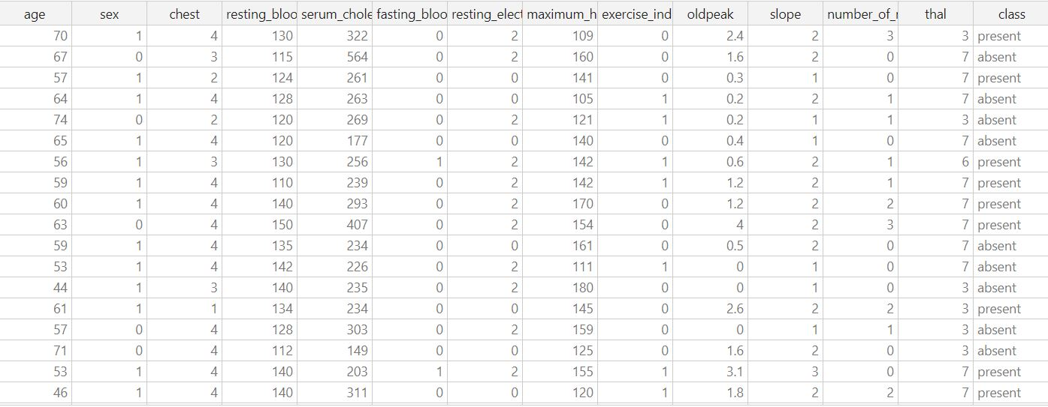
Data Set
Notes:
The first step of any classification problem is to quickly observe the data that we are using to train and test a classification model. Records were obtained from the Cleveland Heart Disease. To avoid bias, the records for each set were selected randomly with no missing values. Here, we have 270 of patients who possess or do not possess heart disease. In this case, the classes in which the model will classify these patients as are 0 (no heart disease) or 1 (with heart disease). We have a roughly even sample of patients, therefore no sampling is to be done.

Slide 8
Attributes
Input attributes
AGE | In Years
SEX | value 1: Male, value 0 : Female
chest pain type | value 1: typical type 1 angina, value 2: typical type angina, value 3: non-angina pain; value 4: asymptomatic
resting blood pressure | mm Hg on admission to the hospital
serum cholestoral | Is the measurement of certain elements in the blood, including the amount of high- and low-density lipoprotein cholesterol (HDL and LDL) in a person's blood in mg/dl.
fasting blood sugar | value 1: > 120 mg/dl; value 0: < 120 mg/dl
resting electrocardiographic results | value 0: normal; value 1: 1 having ST-T wave abnormality; value 2: showing probable or definite left ventricular hypertrophy
Max HR achieved | maximum heart rate achieved
exercise induced angina | value 1: yes; value 0: no
oldpeak | ST depression induced by exercise relative to rest
slope | The slope of the peak exercise ST segment value 1: unsloping; value 2: flat; value 3: downsloping
CA | number of major vessels (0-3) colored by flourosopy
thal | value 3: normal; value 6: fixed defect; value 7: reversible defect
CLASS | Variable to be predicted: Absence (0) or presence (1) of heart disease
Notes:
Furthermore, we have 23 features which indicate whether a patient possess heart disease; some of these include: age, sex, resting blood pressure, serum cholesterol, fasting blood sugar level, maximum heart rate achieved, etc.

Slide 9
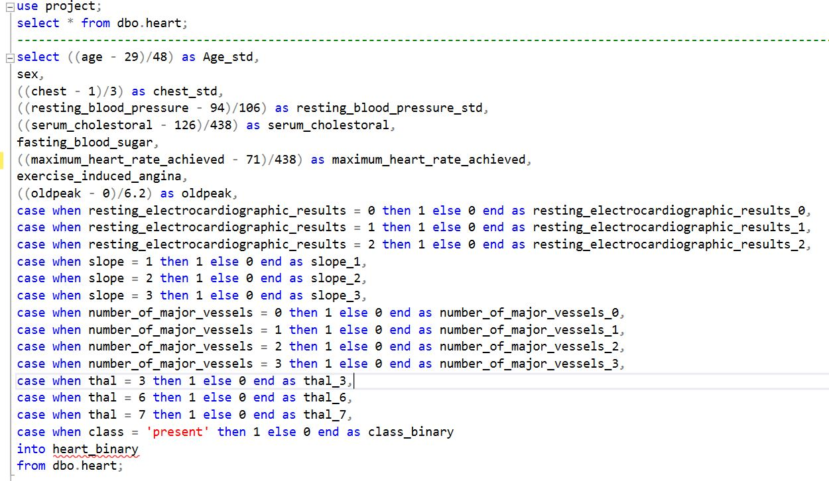
Data Preprocessing
Notes:
The data is then sorted into binary values via smoothing. Smoothing is a form of generalization, normalization, and data cleaning also serve as forms of data reduction. Normalization is defined as the process of organizing data in a database. The attribute is normalized by scaling its values so that they fall within a small specified range, such as 0 to 1.0. Thus the normalization creates a binary table and relationships are established between each attribute. The binary table is created to transform the database into a more flexible unit leading towards the eliminatiion of redundancy, inconsistent dependency and minimizing memory costs.

Slide 10
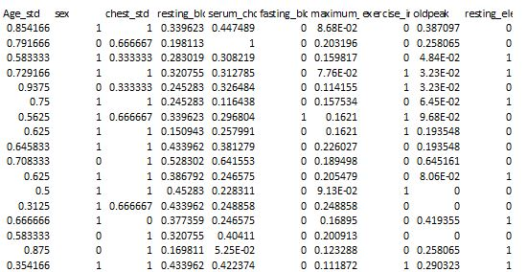
Data Preprocessing
Notes:
Thus the normalization creates a binary table and relationships are established between each attribute. The binary table is created to transform the database into a more flexible unit leading towards the eliminatiion of redundancy, inconsistent dependency and minimizing memory costs.

Slide 11
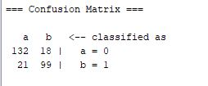

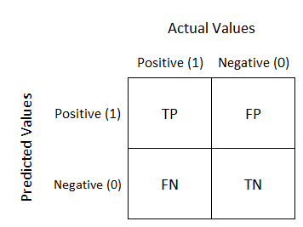
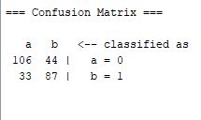
Validating model effectiveness: Confusion Matrix
Naïve Bayes
Neural Network
Random Tree
Notes:
The effectiveness of models was tested using two methods: ROC and Classification Matrix. The purpose was to determine which model gave the highest
percentage of correct predictions for diagnosing patients with a heart disease. Classification Matrix displays the frequency of correct and incorrect predictions. It
compares the actual values in the test dataset with the predicted values in the trained model. In this example, the test dataset contained 120 patients with heart disease and
150 patients without heart disease. The Figures show the results of the Classification Matrix for all the three models. The columns represent actual values (1 for patients with heart disease, ‘0’ for patients with no heart disease) predicted by the models. Naïve Bayes appears to be most effective as it has the highest percentage of correct predictions for patients with heart disease, followed by Neural Network, and Random tree.

Slide 12
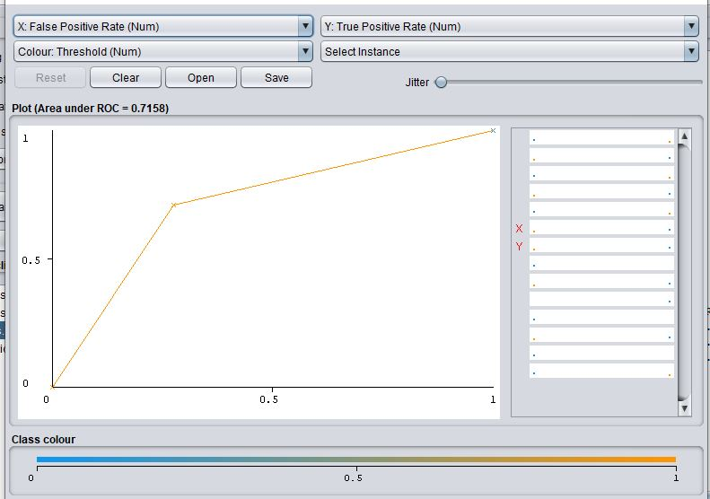
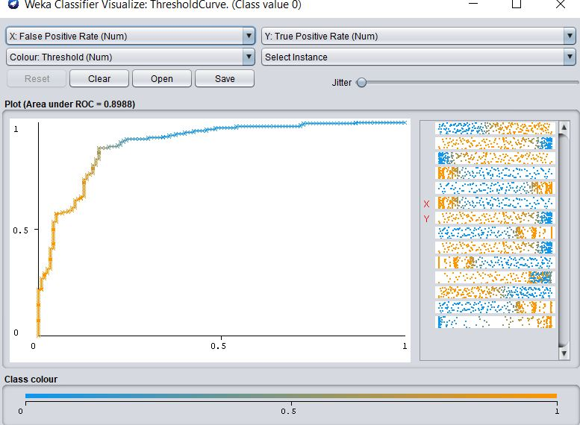
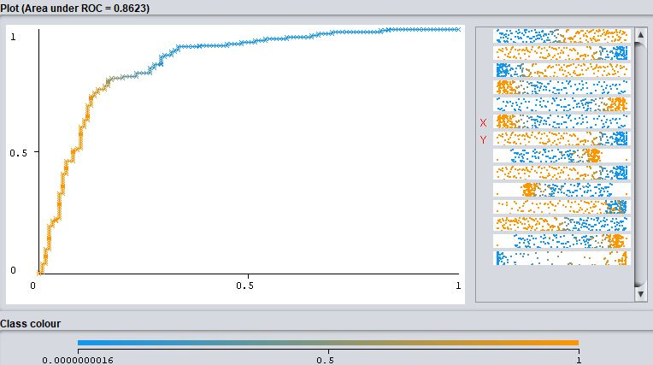
Validating model effectiveness: ROC
classification algorithms | Area under ROC
Random Tree | 0.7518
Neural Network | 0.8623
Naïve Bayes | 0.8988
Notes:
As stated previously, the effectiveness of models was tested using two methods: ROC and Classification Matrix. The purpose was to determine which model gave the highest
percentage of correct predictions for diagnosing patients with a heart disease. The area under the ROC curve ( AUC ) is a measure of how well a parameter can distinguish between two diagnostic groups (with heart disease and without). The X-axis shows the false positive rate (100-Specificity) of the dataset while the Y-axis shows the true positive rate (Sensitivity) of the data both are used to compare predictions. The top left, bottom left, and bottom right image shows show the Random Tree, Neural Network, and Naïve Bayes models respectively. The chart
shows the performance of the models across all possible states. The model ideal line would be at a 45-degree angle, given 50% data tested and 50% would be correctly predicted. If the entire
population is processed, Naïve Bayes model appears to perform better than the other two as it gives the highest number of correct predictions (89.88%) followed by Neural Network (86.23%) and Random Trees (75.18%).

Slide 13
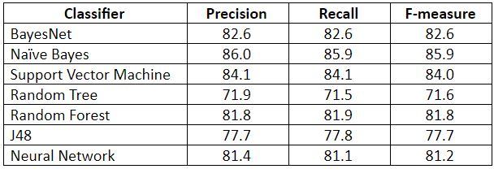
Validating model effectiveness: Precision, Recall, and F-measure
Notes:
Precision and recall are two metrics that are often simultaneously used to verify classification performance. ‘Classic’ precision and recall are derived from the ratios of relevant instances and non-relevant instances. Precision and recall are not often taken into account alone. The two measures are often used together in the F-measure, which provides a single weighted metric to evaluate the overall performance. The results show that the best classifier for this problem is Naïve Bayes (precision of 86.0%, recall of 85.9% and F-measure of 85.9). The model has demonstrated to make the least incorrect predictions, misclassifying 38 out of 270 patients. In this context, neither classifiers are the best performing for this problem. As this is a problem which deals with human life, a classifier needs to achieve a significantly higher classification performance to be considered as being suitable for classifying whether patients have heart disease or not. The reason for this is that, if a doctor is to rely on the results, they could be dispensing drugs to patients who have been classified as having heart disease when they indeed do not have it. This could have more of an impact on their health.

Slide 14
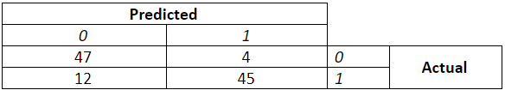
Applying the model on unseen data
Notes:
We can further evaluate the performance of Naïve Bayes on our data set by splitting the data set to training and testing sets. The norm is to have more training instances than testing, as this is the data the classifiers learns from to make predictions on the unseen data (the testing data).
We use Weka’s percentage split function which splits our dataset into 60% training (162 patients) and 40% testing (108 patients). We apply the Naïve Bayes algorithm, which achieves a precision of 86.1%, recall of 85.2% and F-measure of 85.2%. In conclusion, the objective of study was to examine different data mining techniques that can be employed in heart disease prediction. The classifier again shows promising results in terms of classification performance. The Naïve Bayes algorithm misclassifies 16 patients out of 106 with heart disease when do not possess any problems. The next goal would be to maximise the classification performance and reducing the false positives (misclassifications). To do this, we could add more data or include more specific features that are more of an indication of heart disease.

Slide 15

Thank You!
Rjoseph5@masonlive.gmu.edu

